Slide 1
Memory Management
Operating Systems

Slide 2
Main Memory
Operating Systems

Slide 3
Background
Program must be brought (from disk) into memory and placed within a process for it to be run
Main memory and registers are only storage CPU can access directly
Memory unit only sees a stream of addresses + read requests, or address + data and write requests
Register access in one CPU clock (or less)
Main memory can take many cycles, causing a stall, since it does not have the data required to complete the instruction that it is executing
Cache sits between main memory and CPU registers for fast access
Protection of memory required to ensure correct operation

Slide 4
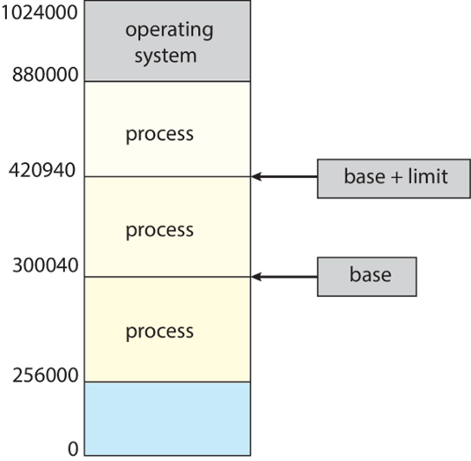
Base and Limit Registers
A pair of base and limit registers define the logical address space
CPU must check every memory access generated in user mode to be sure it is between base and limit for that user

Slide 5
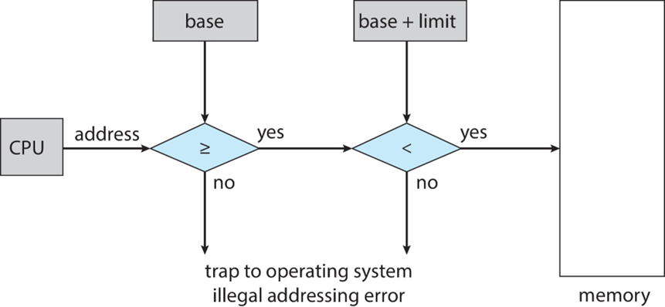
Hardware Address Protection

Slide 6
Operating Systems Address Space

Slide 7
Logical vs. Physical Address Space
The concept of a logical address space that is bound to a separate physical address space is central to proper memory management
Logical address – generated by the CPU; also referred to as virtual address
Physical address – address seen by the memory unit
Logical and physical addresses are the same in compile-time and load-time address-binding schemes; logical (virtual) and physical addresses differ in execution-time address-binding scheme
Logical address space is the set of all logical addresses generated by a program
Physical address space is the set of all physical addresses generated by a program

Slide 8
Operating Systems Paging

Slide 9
Paging
Physical address space of a process can be noncontiguous; process is allocated physical memory whenever the latter is available
Avoids external fragmentation
Avoids problem of varying sized memory chunks
Divide physical memory into fixed-sized blocks called frames
Size is power of 2, between 512 bytes and 16 Mbytes
Divide logical memory into blocks of same size called pages
Keep track of all free frames
To run a program of size N pages, need to find N free frames and load program
Set up a page table to translate logical to physical addresses
Backing store likewise split into pages
Still have Internal fragmentation

Slide 10
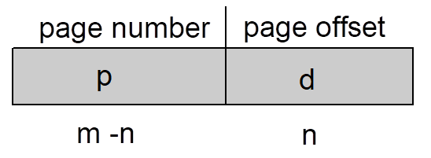
Address Translation Scheme
Address generated by CPU is divided into:
Page number (p) – used as an index into a page table which contains base address of each page in physical memory
Page offset (d) – combined with base address to define the physical memory address that is sent to the memory unit
For given logical address space 2^{m} and page size 2^{n}

Slide 11
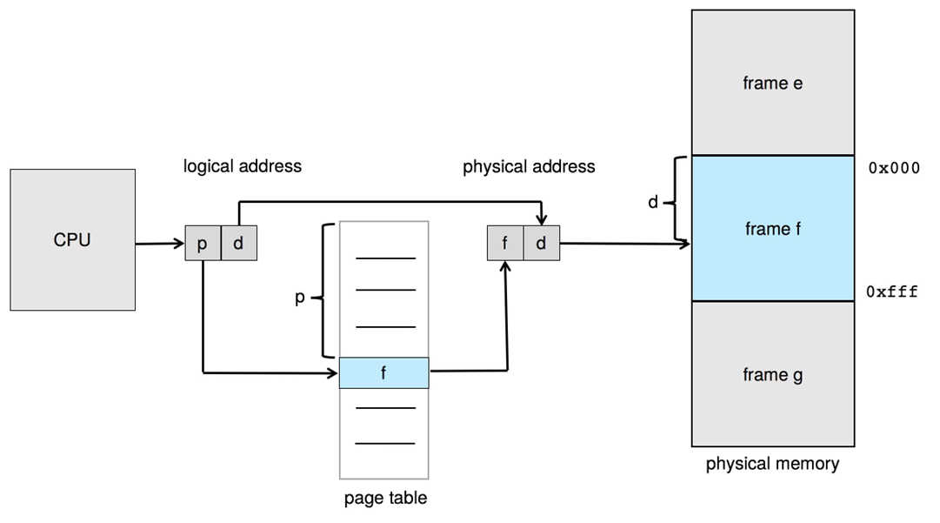
Paging Hardware

Slide 12
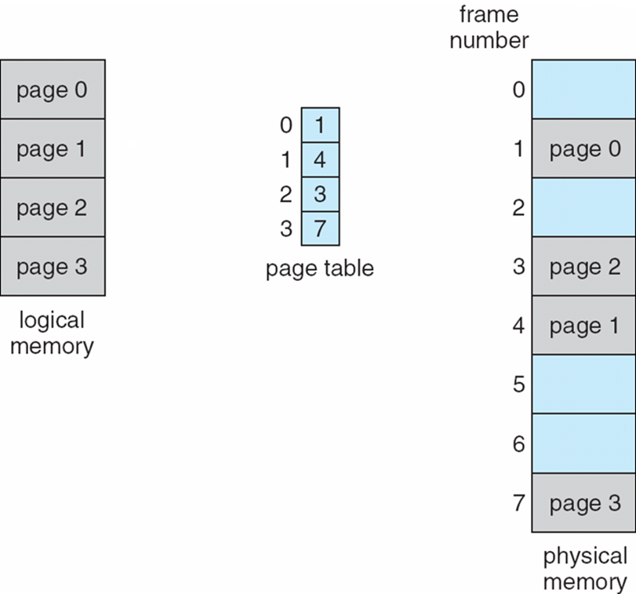
Paging Model of Logical and Physical Memory

Slide 13
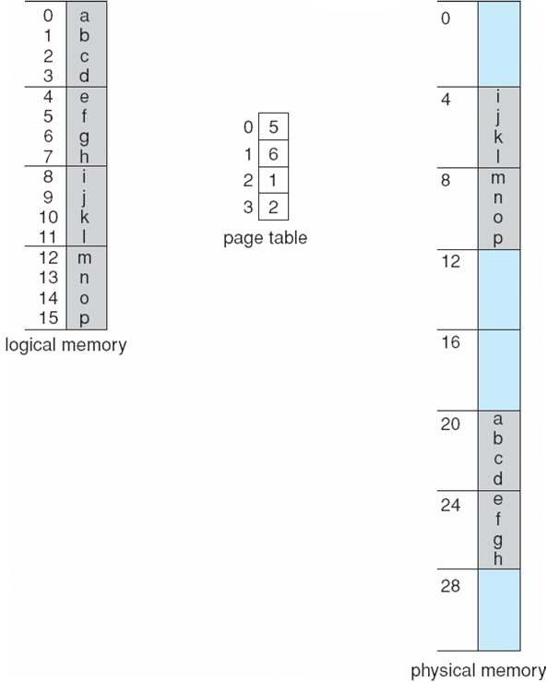
Paging Example
n=2 and m=4
32-byte memory and 4-byte pages

Slide 14
Paging Example
32/4 = 8 frames
0
0
m is used to determine the number of logical addresses, 2^{m} = 16
n indicates the offset within each logical address
1
1
n=2 and m=4
32-byte memory and 4-byte pages
2
2
3
3
Physical memory
4
5
Map logical address 0 (page 0, offset 0) to its corresponding physical address
Map Logical address 3 (page 0, offset 3) to its corresponding physical address
6
7
frameNumber * frameSize + offset

Slide 15
Size of Page
Calculating internal fragmentation
Page size = 2,048 bytes
Process size = 72,766 bytes
35 pages + 1,086 bytes
Internal fragmentation of 2,048 - 1,086 = 962 bytes
Worst case fragmentation = 1 frame – 1 byte
On average fragmentation = 1 / 2 frame size
So small frame sizes desirable?
But each page table entry takes memory to track
Page sizes growing over time
Solaris supports two page sizes – 8 KB and 4 MB
Process view and physical memory now very different
By implementation process can only access its own memory

Slide 16
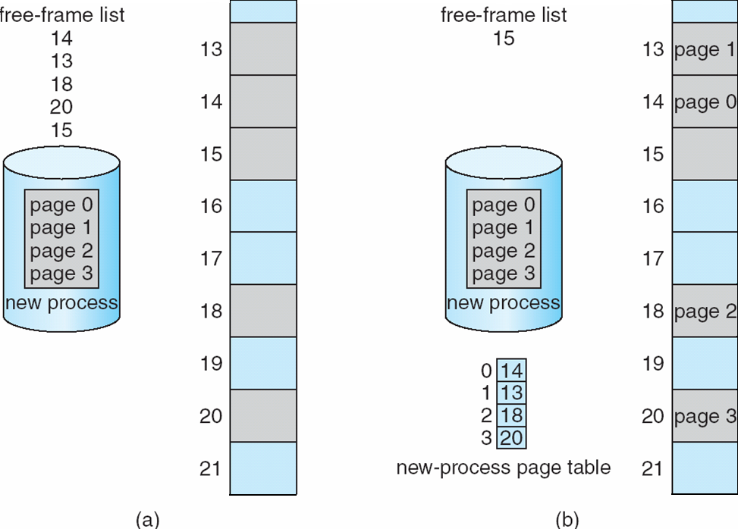
Free Frames
Before allocation
After allocation

Slide 17
Operating Systems Implementation of Page Table

Slide 18
Implementation of Page Table
Page table is kept in main memory
Page-table base register (PTBR) points to the page table
Page-table length register (PTLR) indicates size of the page table
In this scheme every data/instruction access requires two memory accesses
One for the page table and one for the data / instruction
The two memory access problem can be solved by the use of a special fast-lookup hardware cache called associative memory or translation lookaside buffers (TLBs)

Slide 19
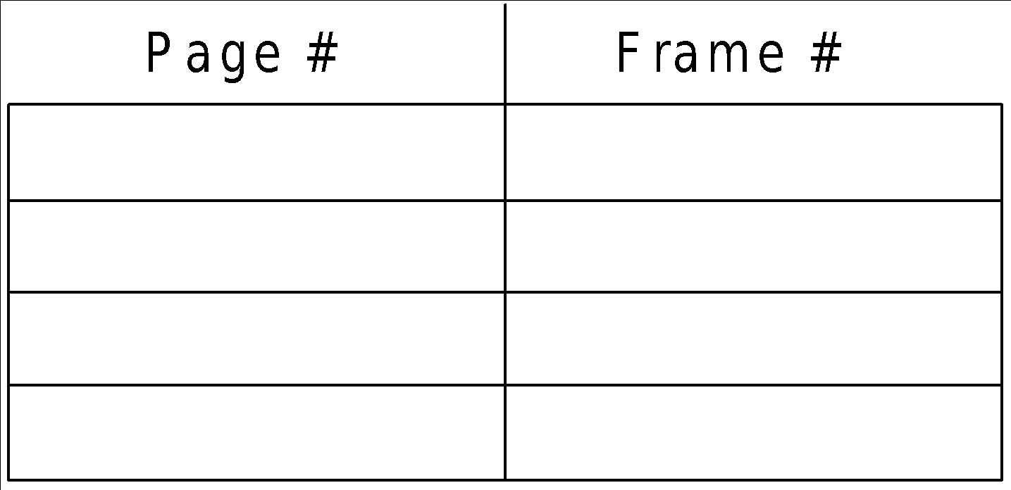
Associative Memory
Associative memory – parallel search
Address translation (p, d)
If p is in associative register, get frame # out
Otherwise get frame # from page table in memory

Slide 20
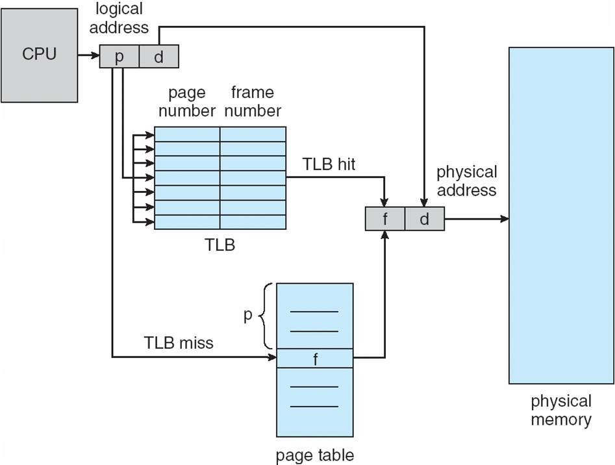
Paging Hardware With TLB

Slide 21
Effective Access Time
Associative Lookup = ε time unit
Can be < 10% of memory access time
Hit ratio = α
Hit ratio – percentage of times that a page number is found in the associative registers;
Effective Access Time (EAT):
Consider α = 80%, ε = 20ns for TLB search, 100ns for memory access
EAT = 0.80 x 120 + 0.20 x 220 = 140ns
Consider more realistic hit ratio -> α = 99%, ε = 20ns for TLB search, 100ns for memory access
EAT = 0.99 x 120 + 0.01 x 220 = 121ns
https://docs.google.com/presentation/u/0/?authuser=0&usp=slides_web

Slide 22
Memory Protection
Memory protection implemented by associating protection bit with each frame to indicate if read-only or read-write access is allowed
Can also add more bits to indicate page execute-only, and so on
Valid-invalid bit attached to each entry in the page table:
“valid” indicates that the associated page is in the process’ logical address space, and is thus a legal page
“invalid” indicates that the page is not in the process’ logical address space
Or use page-table length register (PTLR)
Any violations result in a trap to the kernel

Slide 23
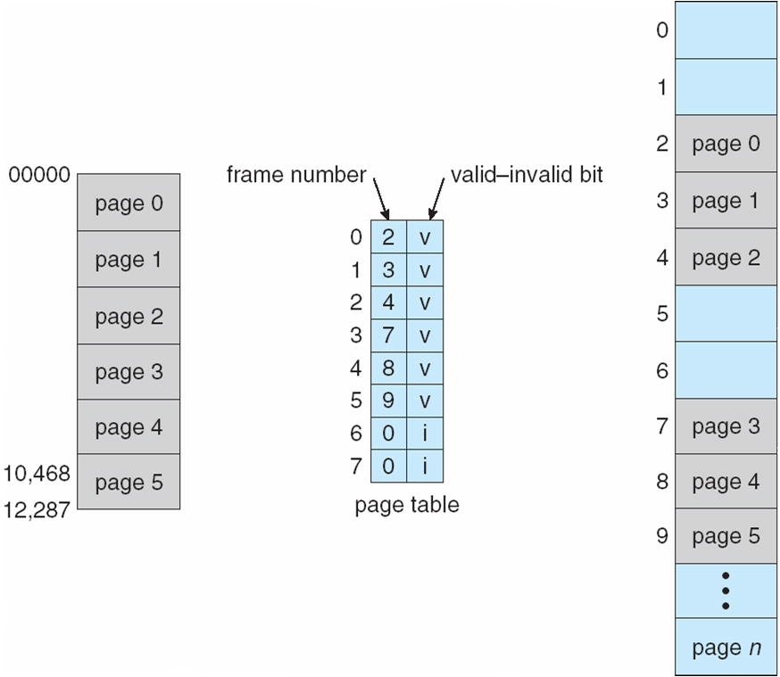
Valid (v) or Invalid (i) Bit In A Page Table

Slide 24
Operating Systems Shared Pages

Slide 25
Shared Pages
Shared code
One copy of read-only (reentrant) code shared among processes (i.e., text editors, compilers, window systems)
Similar to multiple threads sharing the same process space
Also useful for inter-process communication if sharing of read-write pages is allowed
Private code and data
Each process keeps a separate copy of the code and data
The pages for the private code and data can appear anywhere in the logical address space

Slide 26
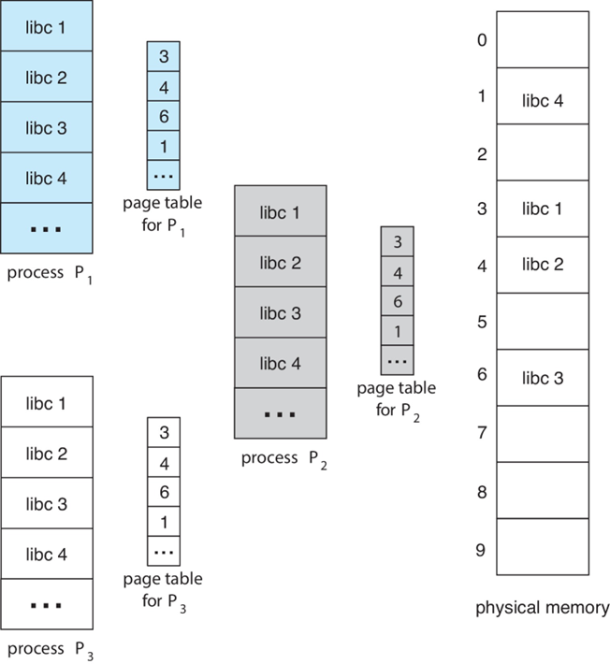
Shared Pages Example

Slide 27
Operating Systems Hierarchical Page Table

Slide 28
Structure of the Page Table
Memory structures for paging can get huge using straightforward methods
Consider a 32-bit logical address space as on modern computers
Page size of 4 KB (2¹²)
Page table would have 1 million entries (2³² / 2¹²)
If each entry is 4 bytes -> 4 MB of physical address space / memory for page table alone
That amount of memory used to cost a lot
Don’t want to allocate that contiguously in main memory

Slide 29
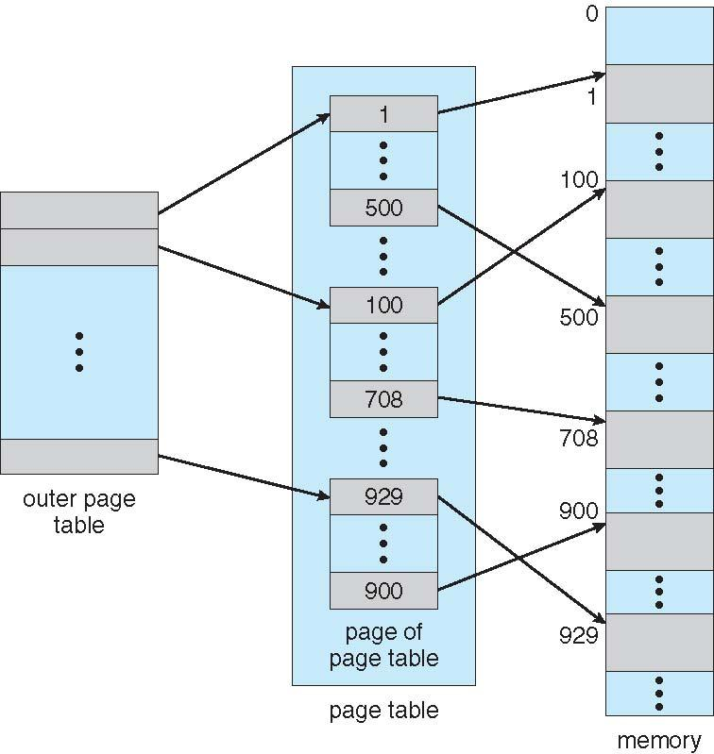
Hierarchical Page Tables
Break up the logical address space into multiple page tables
A simple technique is a two-level page table
We then page the page table

Slide 30
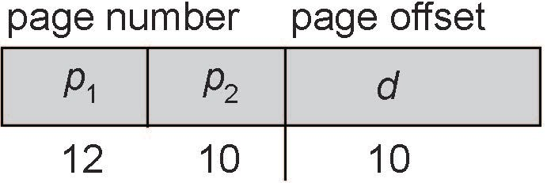
Two-Level Paging Example
A logical address (on 32-bit machine with 1K page size) is divided into:
a page number consisting of 22 bits
a page offset consisting of 10 bits
Since the page table is paged, the page number is further divided into:
a 12-bit page number
a 10-bit page offset
Thus, a logical address is as follows:
where p₁ is an index into the outer page table, and p₂ is the displacement within the page of the inner page table
Known as forward-mapped page table

Slide 31
Virtual Memory
Operating Systems

Slide 32
Background
The term “virtual memory” refers to something which appears to be present but actually it is not.
The virtual memory technique allows users to use more memory for a program than the real memory of a computer.
Virtual memory is a concept that we use when we have processes that exceed the main memory.
When computer runs out of physical memory, it writes its requirement to the hard disc in a swap file as “virtual memory”.

Slide 33
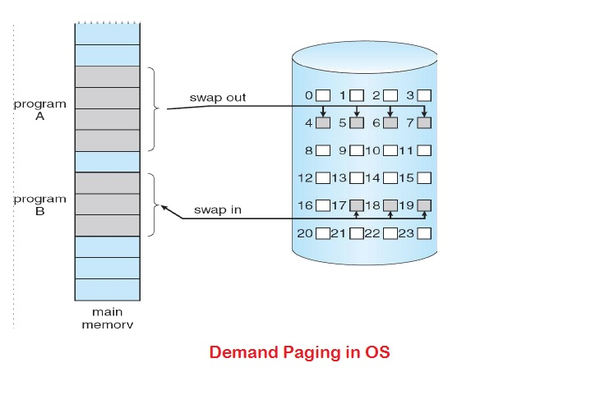
Demand Paging
Bring a page into memory only when it is needed
Less I/O needed
Less memory needed
Faster response
More users
Disadvantage: Page fault interrupt
Required hardware support:
Page Table with valid-invalid bit
Secondary memory

Slide 34
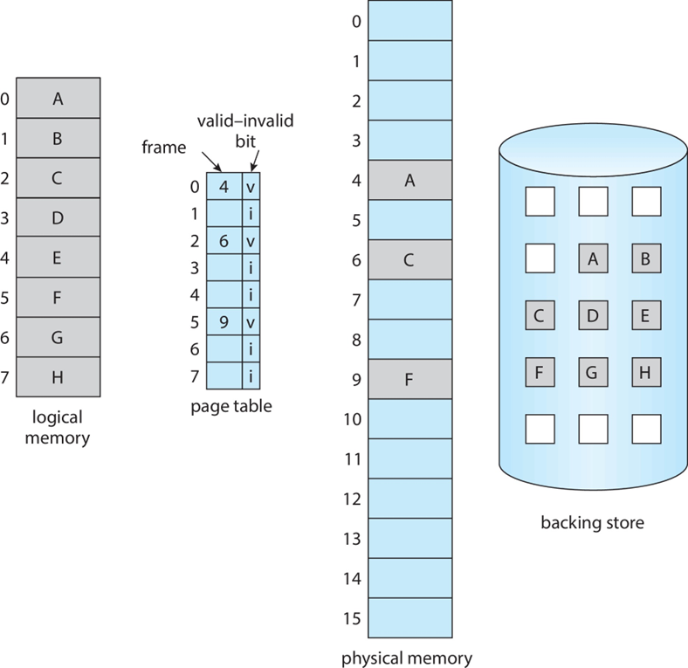
Valid-Invalid Bit
An extra bit in the page table which indicates the existence of the page in the main memory.
Attempt to access page
If page is valid (in memory) then continue processing instruction as normal.
If page is invalid then a page-fault trap / page-fault interrupt occurs.
Page is needed ⇒ reference to it
Invalid reference ⇒ abort
Not-in-memory ⇒ bring to memory

Slide 35
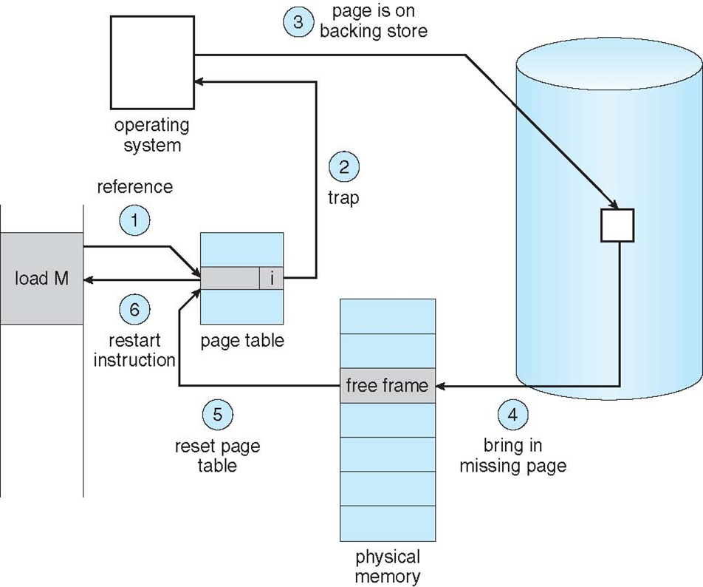
Page Fault
If there is ever a reference to a page, first reference will trap to OS ⇒ page fault
OS looks at another table to decide:
Invalid reference ⇒ abort.
Just not in memory.
Find empty/ free frame.
Load page from disk into frame.
Reset tables, validation bit = 1.
Restart instruction that caused page fault

Slide 36
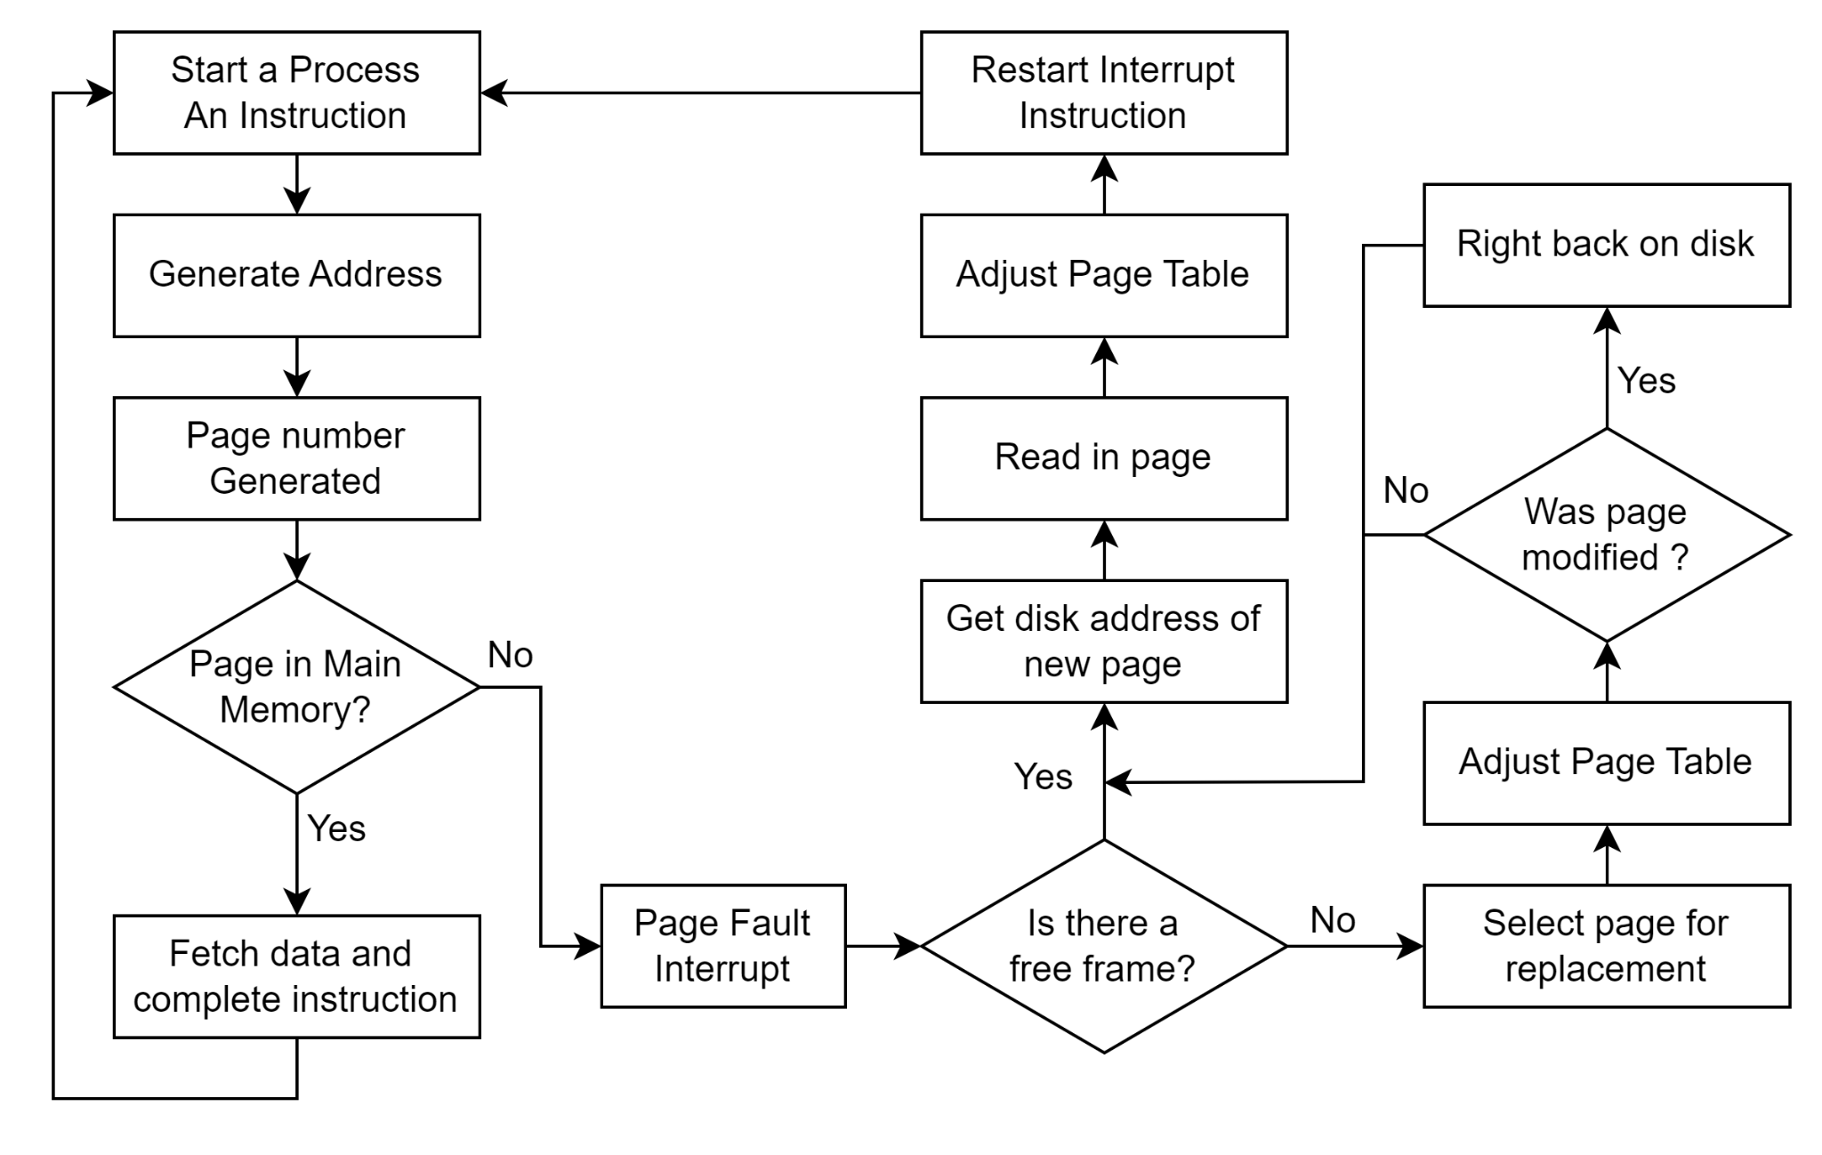
Demand Paging Flowchart

Slide 37
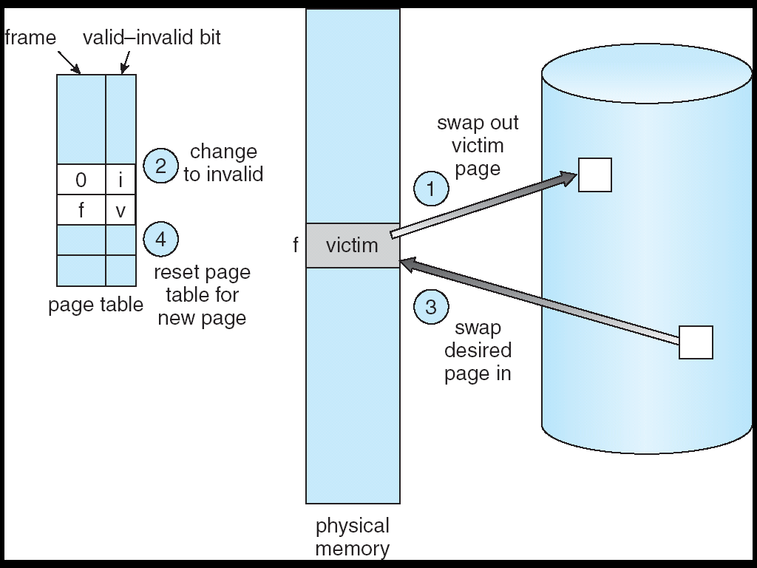
Page Replacement
Page Replacement Algorithms:
FIFO (First In First Out)
LRU (Least Recently Used)
OPT (Optimal)

Slide 38

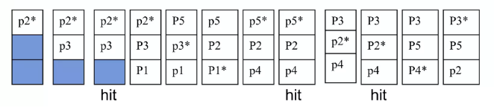
FIFO (First In First Out)
Selects the page for replacement that has been in the memory for the longest amount of time

Slide 39
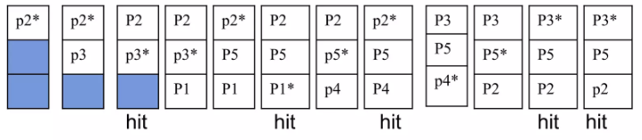
LRU (Least Recently Used)
Replace the least recently used page in the past
Can be implemented by associating a counter with every page that is in main memory

Slide 40
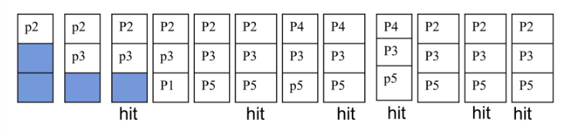
Optimal
Replace the page which is not used in longest dimension of time in future

